Slide 1
Neural Network
Satyabrata Aich

Slide 2
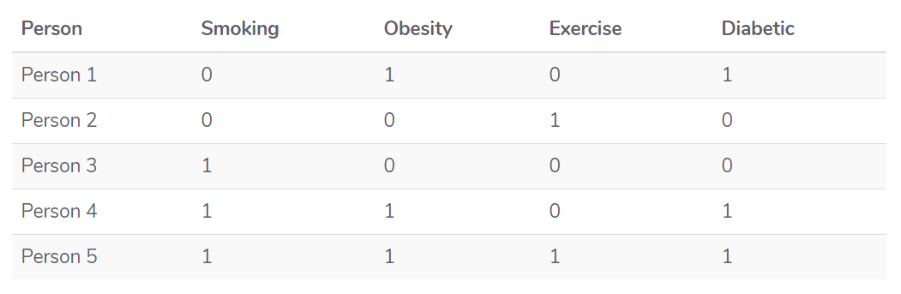
Problem
It is clearly evident from the dataset that a person's obesity is indicative of him being diabetic. Our task is to create a neural network that is able to predict whether an unknown person is diabetic or not given data about his exercise habits, obesity, and smoking habits. This is a type of supervised learning problem where we are given inputs and corresponding correct outputs and our task is to find the mapping between the inputs and the outputs.

Slide 3
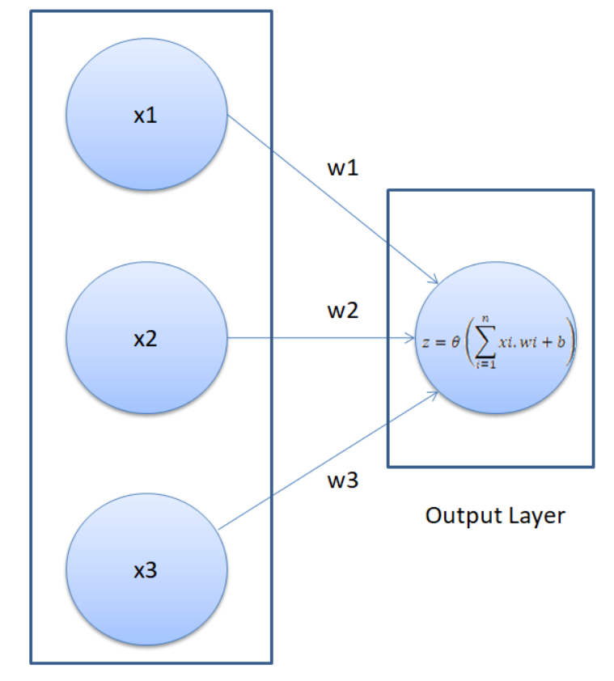

Slide 4
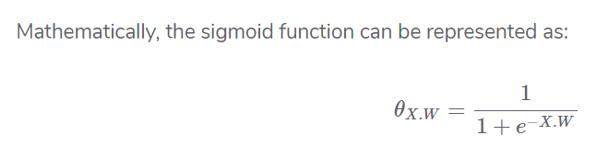
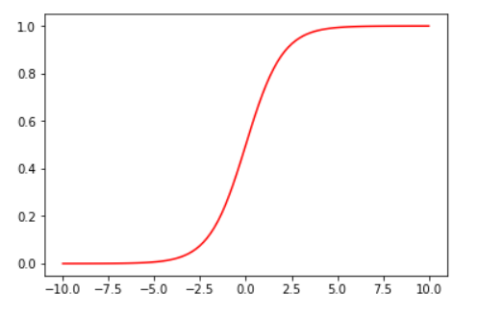
Feed Forward
X.W=x1w1+x2w2+x3w3+b
The result from Step 1 can be a set of any values. However, in our output we have the values in the form of 1 and 0. We want our output to be in the same format. To do so we need an activation function, which squashes input values between 1 and 0. One such activation function is the sigmoid function.
The sigmoid function returns 0.5 when the input is 0. It returns a value close to 1 if the input is a large positive number. In case of negative input, the sigmoid function outputs a value close to zero.

Slide 5

Back Propagation
The principle behind the working of a neural network is simple. We start by letting the network make random predictions about the output. We then compare the predicted output of the neural network with the actual output.
Next, we fine-tune our weights and the bias in such a manner that our predicted output becomes closer to the actual output, which is basically known as "training the neural network".
The first step in the back propagation section is to find the "cost" of the predictions. The cost of the prediction can simply be calculated by finding the difference between the predicted output and the actual output. The higher the difference, the higher the cost will be.
There are several other ways to find the cost, but we will use the mean squared error cost function. A cost function is simply the function that finds the cost of the given predictions.

Slide 6
The second step is to minimize the cot function:
Our ultimate purpose is to fine-tune the knobs of our neural network in such a way that the cost is minimized. If your look at our neural network, you'll notice that we can only control the weights and the bias. Everything else is beyond our control. We cannot control the inputs, we cannot control the dot products, and we cannot manipulate the sigmoid function.
In order to minimize the cost, we need to find the weight and bias values for which the cost function returns the smallest value possible. The smaller the cost, the more correct our predictions are.
This is an optimization problem where we have to find the function minima.
To find the minima of a function, we can use the gradient decent algorithm. The gradient decent algorithm can be mathematically represented as follows:
Here in the above equation, J is the cost function.
Basically what the above equation says is: find the partial derivative of the cost function with respect to each weight
and bias and subtract the result from the existing weight values to get the new weight values.

Slide 7
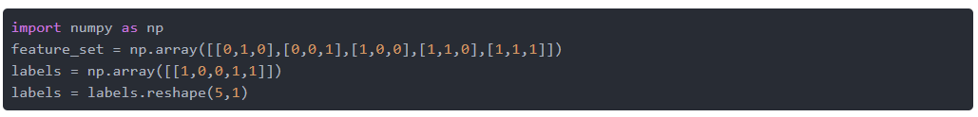
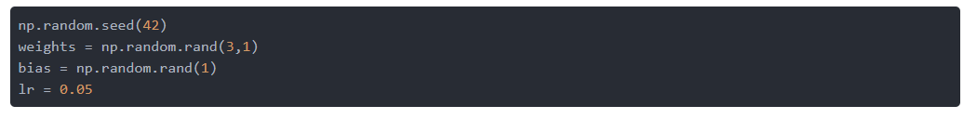
Neural Network Implementation in Python

Slide 8
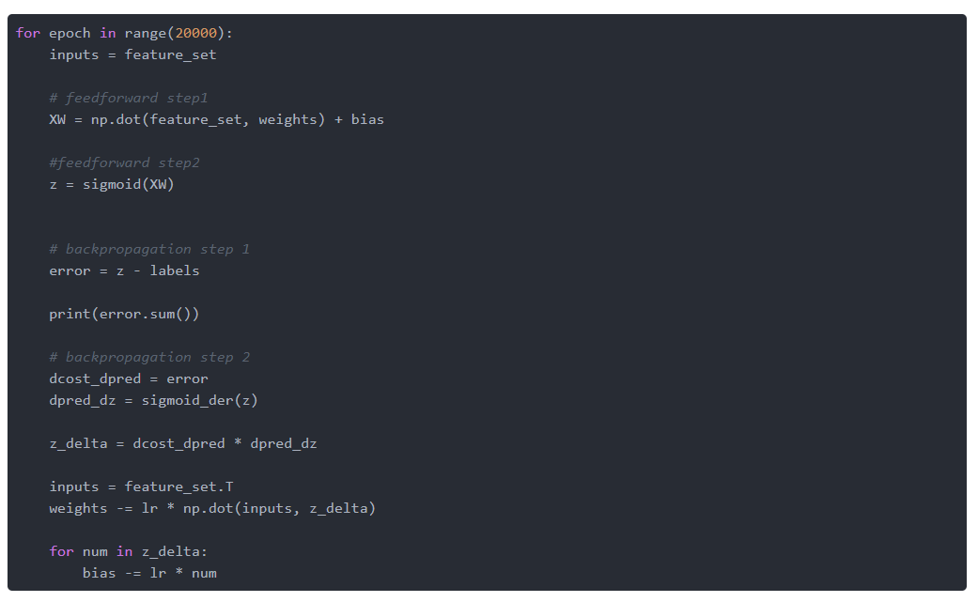

Slide 9
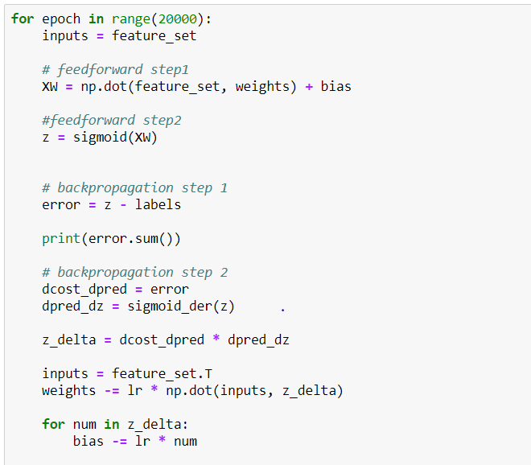
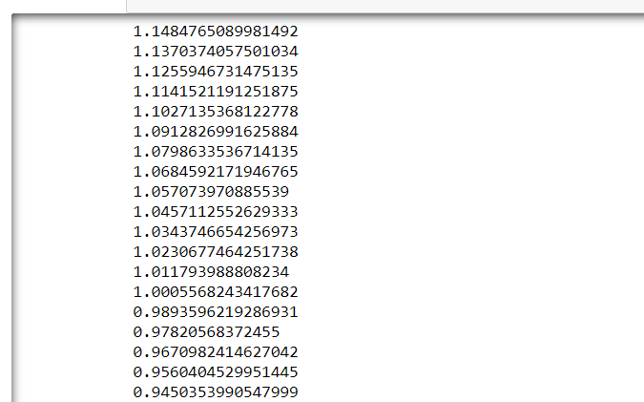

Slide 10
